Slide 1
Hoops, haddock, cascade, oriole, Ervin and valley view heights paving
Recommendation of bid award 2019-022

Slide 2
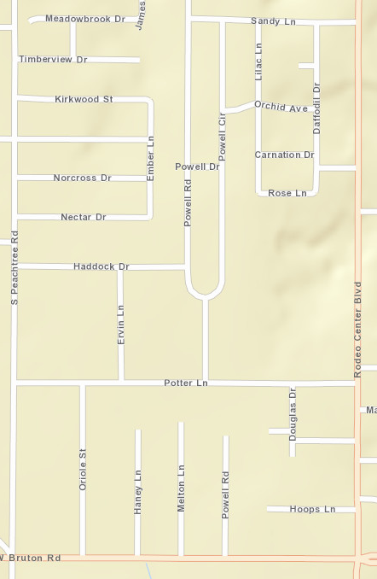
PROJECT AREA
Area was selected as part of the third round of streets in the Real. Texas. Roads. program
Streets were split into two phases
Phase 1
Phase 2

Slide 3
Phase 1A - Utility
Water and Sewer Replacements
Contract 2019-025:
  Awarded Amount: $719,930
  Council Awarded on March 4, 2019
  Construction started April 22, 2019
  Anticipated Completion September 9, 2019
Status
  Completed sewer replacement on Oriole
  Currently working on sewer on Ervin and water on Oriole

Slide 4
Phase 1b – paving rehab
Paving Work
Contract 2019-022:
  Awarded Amount: $1,134,358.49
  Anticipated Council Award May 20, 2019
  Anticipated Construction start June 24, 2019
  Anticipated Completion December 21, 2019
Multiple Rehabilitation Methods Included

Slide 5
Phase 2 – utilities and paving
Design Contract:
  Awarded Amount: $262,790
  Council Awarded on Feb 4, 2019
  Anticipated Construction Start Early 2020
Status
  30% plans received this month for review

Slide 6
Paving rehabilitation methods

Slide 7
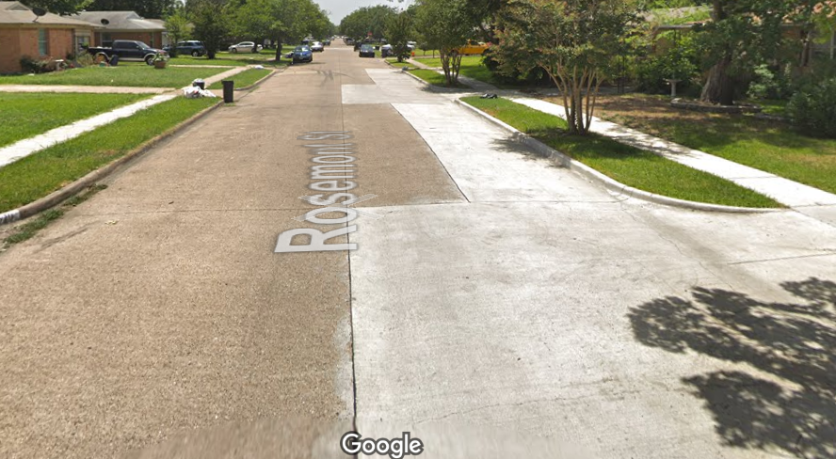
Paving rehab methods
Spot Repair Method
Localized spot repair is full-depth replacement at select areas. The localized full-depth repair can be as small as a 3’x3’ area or a much longer stretch of pavement.
Phase 1
Phase 2

Slide 8
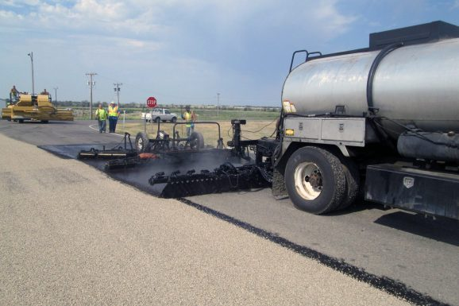
Paving rehab methods
Seal Coat Method
Seal coat treatment is a mix of asphalt emulsion and aggregate applied to the existing asphalt pavement surface. Treatment seals the surface to prevent water from penetrating and deteriorating the subgrade.
Phase 1
Phase 2
Photo from http://www.interstateeng.com/archives/projects/scrub-seal-street-improvements/

Slide 9
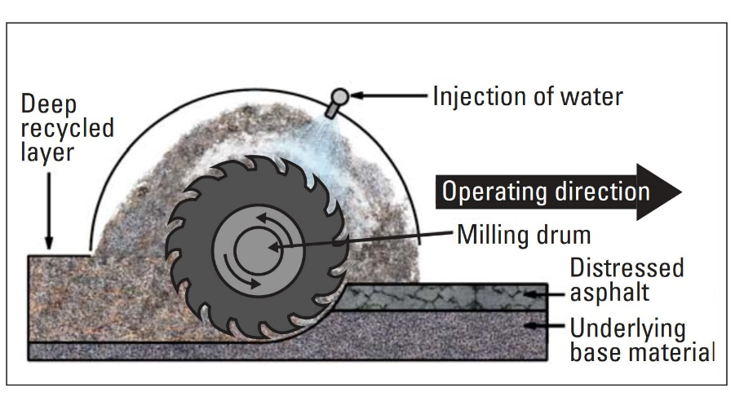
Paving rehab methods
Asphalt Reclamation Method
Asphalt reclamation is for use on existing asphalt streets and involves pulverizing the existing asphalt surface into small pieces and then mixing the pulverized asphalt, base material and a stabilizer (lime, cement or both) to create a new stabilized sub-base. After the base material is prepared, a new layer of asphalt is placed on top. Curb and gutter and sidewalk will be replaced as necessary.
Phase 1
Phase 2
Photo from https://cncement.org/guide-to-full-depth-reclamation-fdr-with-cement/

Slide 10
Paving rehab methods
Full Reconstruction Method
Full reconstruction is a complete demolition and rebuild of a street. The paving surface will be determined during design and based on costs. All curb and gutter and sidewalk is expected to be replaced. This method requires full design and use of outside design consultants.
Phase 1
Phase 2

Slide 11
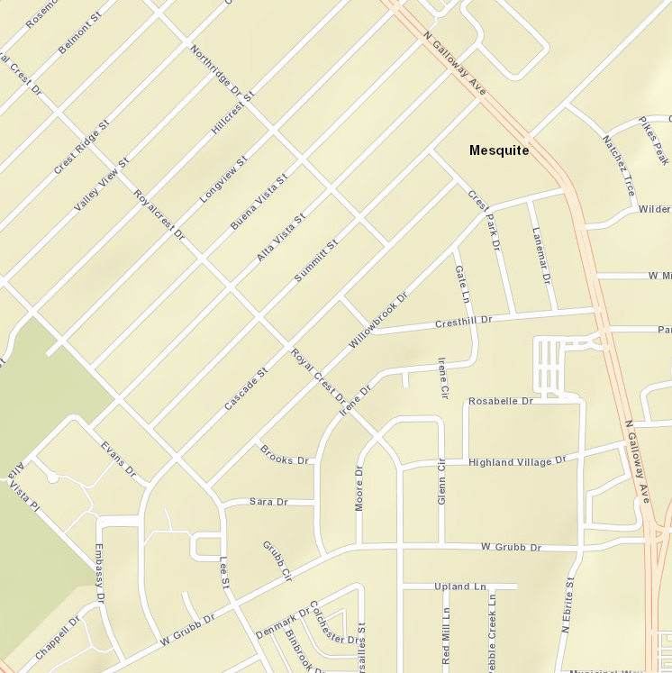
Paving rehab methods
Mill and Asphalt Overlay Method
Concrete streets from third round added to asphalt contract
Phase 1
Phase 2

